Slide 1
Data and Computer Communications
Chapter 13 – Congestion in Data Networks
Eighth Edition
by William Stallings
Lecture slides by Lawrie Brown
Notes:
Lecture slides prepared by Dr Lawrie Brown (UNSW@ADFA) for “Data and Computer Communications”, 8/e, by William Stallings, Chapter 13 “Congestion in Data Networks”.

Slide 2
Congestion in Data Networks
At St. Paul's a great throng crammed the platform. She saw a sea of faces, each stamped with a kind of purposeful, hungry urgency, a determination to get into this train. As before, when she was on the Northern Line, she thought there must be some rule, some operating law, that would stop more than a limited, controlled number getting in. Authority would appear and stop it.
—King Solomon's Carpet, Barbara Vine (Ruth Rendell)
Notes:
This quote is from the start of Stallings DCC8e 13, points to the issues of handling congestion.

Slide 3
What Is Congestion?
congestion occurs when the no of packets being transmitted through the network approaches the packet handling capacity of the network
congestion control aims to keep no of packets below a level at which performance falls off dramatically
a data network is a network of queues
generally 80% utilization is critical
finite queues mean data may be lost
Notes:
Congestion occurs when the number of packets being transmitted through a network begins to approach the packet-handling capacity of the network. The objective of congestion control is to maintain the number of packets within the network below the level at which performance falls off dramatically.
A data network or internet is a network of queues. At each node (data network switch, internet router), there is a queue of packets for each outgoing channel. If the rate at which packets arrive and queue up exceeds the rate at which packets can be transmitted, the queue size grows without bound and the delay experienced by a packet goes to infinity. Even if the packet arrival rate is less than the packet transmission rate, queue length will grow dramatically as the arrival rate approaches the transmission rate. As a rule of thumb, when the line for which packets are queuing becomes more than 80% utilized, the queue length grows at an alarming rate. This growth in queue length means that the delay experienced by a packet at each node increases. Further, since the size of any queue is finite, as queue length grows, eventually the queue must overflow.

Slide 4
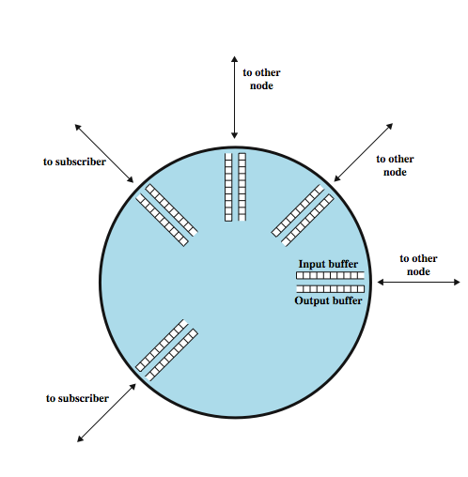
Queues at a Node
Notes:
Consider the queuing situation at a single packet switch or router, such as is illustrated in Stallings DCC8e Figure 13.1. Any given node has a number of I/O ports attached to it: one or more to other nodes, and zero or more to end systems. On each port, packets arrive and depart. We can consider that there are two buffers, or queues, at each port, one to accept arriving packets, and one to hold packets that are waiting to depart. In practice, there might be two fixed-size buffers associated with each port, or there might be a pool of memory available for all buffering activities. In the latter case, we can think of each port having two variable-size buffers associated with it, subject to the constraint that the sum of all buffer sizes is a constant.
In any case, as packets arrive, they are stored in the input buffer of the corresponding port. The node examines each incoming packet, makes a routing decision, and then moves the packet to the appropriate output buffer. Packets queued for output are transmitted as rapidly as possible; this is, in effect, statistical time division multiplexing. If packets arrive too fast for the node to process them (make routing decisions) or faster than packets can be cleared from the outgoing buffers, then eventually packets will arrive for which no memory is available.

Slide 5
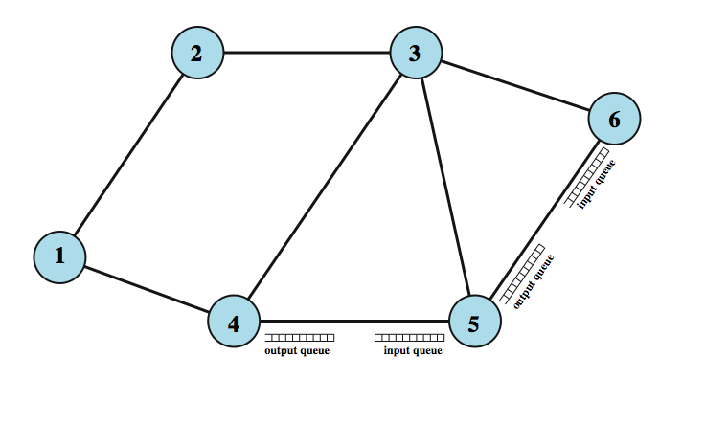
Interaction of Queues
Flow
Control
Notes:
When such a saturation point is reached, one of two general strategies can be adopted. The first such strategy is to discard any incoming packet for which there is no available buffer space. The alternative is for the node that is experiencing these problems to exercise some sort of flow control over its neighbors so that the traffic flow remains manageable. But, as Stallings DCC8e Figure 13.2 illustrates, each of a node's neighbors is also managing a number of queues. If node 6 restrains the flow of packets from node 5, this causes the output buffer in node 5 for the port to node 6 to fill up. Thus, congestion at one point in the network can quickly propagate throughout a region or the entire network. While flow control is indeed a powerful tool, we need to use it in such a way as to manage the traffic on the entire network.

Slide 6
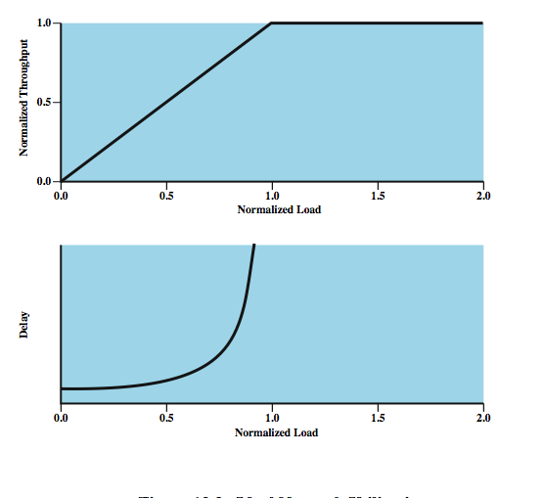
Ideal
Network
Utilization
Infinite buffers
No signaling
overhead
Notes:
Stallings DCC8e Figure 13.3 suggests the ideal goal for network utilization. The top graph plots the steady-state total throughput (number of packets delivered to destination end systems) through the network as a function of the offered load (number of packets transmitted by source end systems), both normalized to the maximum theoretical throughput of the network. For example, if a network consists of a single node with two full-duplex 1-Mbps links, then the theoretical capacity of the network is 2 Mbps, consisting of a 1-Mbps flow in each direction. In the ideal case, the throughput of the network increases to accommodate load up to an offered load equal to the full capacity of the network; then normalized throughput remains at 1.0 at higher input loads. Note, however, what happens to the end-to-end delay experienced by the average packet even with this assumption of ideal performance. At negligible load, there is some small constant amount of delay. As the load on the network increases, queuing delays at each node are added to this fixed amount of delay. When the load exceeds the network capacity, delays increase without bound. Suppose that each node in the network is equipped with buffers of infinite size and suppose that the input load exceeds network capacity. Under ideal conditions, the network will continue to sustain a normalized throughput of 1.0. Therefore, the rate of packets leaving the network is 1.0. Because the rate of packets entering the network is greater than 1.0, internal queue sizes grow. In the steady state, with input greater than output, these queue sizes grow without bound and therefore queuing delays grow without bound. This figure represents the ideal, but unattainable, goal. No scheme can exceed its performance.

Slide 7
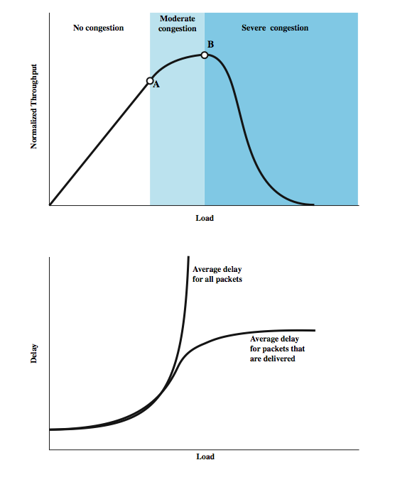
Effects of
Congestion -
No Control
Notes:
In practice, buffers are finite, leading to buffer overflow, and attempts to control congestion consume network capacity in the exchange of control signals. Let us consider what happens if no attempt is made to control congestion or to restrain input from end systems. The details will, of course, differ depending on network configuration and on the statistics of the presented traffic. However, the graphs in Stallings DCC8e Figure 13.4 depict the devastating outcome in general terms.
At light loads, throughput and hence network utilization increases as the offered load increases. As the load continues to increase, a point is reached (point A in the plot) beyond which the throughput of the network increases at a rate slower than the rate at which offered load is increased. This is due to network entry into a moderate congestion state. In this region, the network continues to cope with the load, although with increased delays. For the routing function to work, an increased number of routing messages must be exchanged between nodes to alert each other to areas of congestion; this overhead reduces the capacity for data packets.
As the load on the network continues to increase, the queue lengths of the various nodes continue to grow. Eventually, a point is reached (point B in the plot) beyond which throughput actually drops with increased offered load. When the buffers at a node become full, the node must discard packets. Thus, the sources must retransmit the discarded packets in addition to new packets. Under these circumstances, the effective capacity of the system declines to zero.

Slide 8
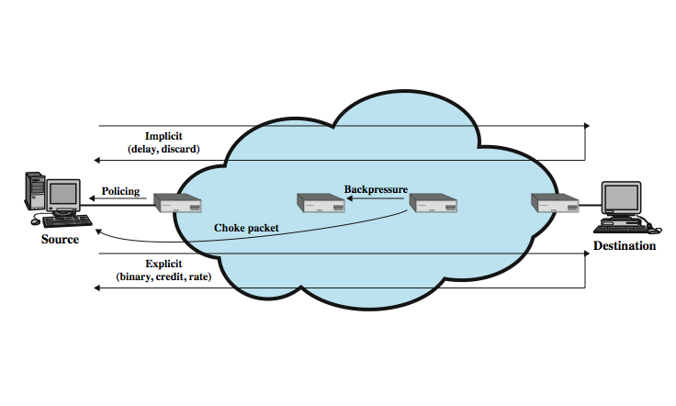
Mechanisms for
Congestion Control
Notes:
In this book, we discuss various techniques for controlling congestion in packet-switching, frame relay, and ATM networks, and in IP-based internets. To give context to this discussion, Stallings DCC8e Figure 13.5 provides a general depiction of important congestion control techniques, which include:
backpressure
choke packets
implicit congestion signaling
explicit congestion signaling

Slide 9
Backpressure
if node becomes congested it can slow down or halt flow of packets from other nodes
  cf. backpressure in blocked fluid pipe
  may mean that other nodes have to apply control on incoming packet rates
  propagates back to source
can restrict to high traffic logical connections
used in connection-oriented nets that allow hop by hop congestion control (eg. X.25)
not used in ATM nor frame relay
only recently developed for IP
Notes:
Backpressure is a technique for congestion control, similar to backpressure in fluids flowing down a pipe. When the end of a pipe is closed (or restricted), the fluid pressure backs up the pipe to the point of origin, where the flow is stopped (or slowed). Backpressure can be exerted on the basis of links or logical connections (e.g., virtual circuits). Referring again to Stallings DCC8e Figure 13.2, if node 6 becomes congested (buffers fill up), then node 6 can slow down or halt the flow of all packets from node 5 (or node 3, or both nodes 5 and 3). If this restriction persists, node 5 will need to slow down or halt traffic on its incoming links. This flow restriction propagates backward (against the flow of data traffic) to sources, which are restricted in the flow of new packets into the network. Backpressure can be selectively applied to logical connections, so that the flow from one node to the next is only restricted or halted on some connections, generally the ones with the most traffic. In this case, the restriction propagates back along the connection to the source.
Backpressure is of limited utility. It can be used in a connection-oriented network that allows hop-by-hop (from one node to the next) flow control. X.25-based packet-switching networks typically provide this feature. However, neither frame relay nor ATM has any capability for restricting flow on a hop-by-hop basis. In the case of IP-based internets, there have traditionally been no built-in facilities for regulating the flow of data from one router to the next along a path through the internet. Recently, some flow-based schemes have been developed; this topic is introduced in Stallings DCC8e Part Five.

Slide 10
Choke Packet
a control packet
  generated at congested node
  sent to source node
  eg. ICMP source quench
    from router or destination
    source cuts back until no more source quench message
    sent for every discarded packet, or anticipated
is a rather crude mechanism
Notes:
A choke packet is a control packet generated at a congested node and transmitted back to a source node to restrict traffic flow. An example of a choke packet is the ICMP (Internet Control Message Protocol) Source Quench packet. Either a router or a destination end system may send this message to a source end system, requesting that it reduce the rate at which it is sending traffic to the internet destination. On receipt of a source quench message, the source host should cut back the rate at which it is sending traffic to the specified destination until it no longer receives source quench messages. The source quench message can be used by a router or host that must discard IP datagrams because of a full buffer. In that case, the router or host will issue a source quench message for every datagram that it discards. In addition, a system may anticipate congestion and issue source quench messages when its buffers approach capacity. In that case, the datagram referred to in the source quench message may well be delivered. Thus, receipt of a source quench message does not imply delivery or nondelivery of the corresponding datagram. The choke package is a relatively crude technique for controlling congestion. More sophisticated forms of explicit congestion signaling are discussed subsequently.

Slide 11
Implicit Congestion Signaling
transmission delay increases with congestion
hence a packet may be discarded
source detects this implicit congestion indication
useful on connectionless (datagram) networks
  eg. IP based
    (TCP includes congestion and flow control - see chapter 17)
used in frame relay LAPF (control protocol)
  End-to-end
  Capable of detecting lost frames and adjusting the flow of data accordingly
Notes:
When network congestion occurs, two things may happen: (1) The transmission delay for an individual packet from source to destination increases, so that it is noticeably longer than the fixed propagation delay, and (2) packets are discarded. If a source is able to detect increased delays and packet discards, then it has implicit evidence of network congestion. If all sources can detect congestion and, in response, reduce flow on the basis of congestion, then the network congestion will be relieved. Thus, congestion control on the basis of implicit signaling is the responsibility of end systems and does not require action on the part of network nodes. Implicit signaling is an effective congestion control technique in connectionless, or datagram, configurations, such as datagram packet-switching networks and IP-based internets. In such cases, there are no logical connections through the internet on which flow can be regulated. However, between the two end systems, logical connections can be established at the TCP level. TCP includes mechanisms for acknowledging receipt of TCP segments and for regulating the flow of data between source and destination on a TCP connection. TCP congestion control techniques based on the ability to detect increased delay and segment loss are discussed in Stallings DCC8eChapter 20. Implicit signaling can also be used in connection-oriented networks. For example, in frame relay networks, the LAPF control protocol, which is end to end, includes facilities similar to those of TCP for flow and error control. LAPF control is capable of detecting lost frames and adjusting the flow of data accordingly.

Slide 12
Explicit Congestion Signaling
network alerts end systems of increasing congestion
end systems take steps to reduce offered load
Backwards
  congestion avoidance notification in opposite direction to packet required
Forwards
  congestion avoidance notification in same direction as packet required
Notes:
It is desirable to use as much of the available capacity in a network as possible but still react to congestion in a controlled and fair manner. This is the purpose of explicit congestion avoidance techniques, where the network alerts end systems to growing congestion within the network and the end systems take steps to reduce the offered load to the network. Typically, explicit congestion control techniques operate over connection-oriented networks and control the flow of packets over individual connections. Explicit congestion signaling approaches can work in one of two directions:
• Backward: Notifies the source that congestion avoidance procedures should be initiated where applicable for traffic in the opposite direction of the received notification. It indicates that the packets that the user transmits on this logical connection may encounter congested resources. Backward information is transmitted either by altering bits in a header of a data packet headed for the source to be controlled or by transmitting separate control packets to the source.
• Forward: Notifies the user that congestion avoidance procedures should be initiated where applicable for traffic in the same direction as the received notification. It indicates that this packet, on this logical connection, has encountered congested resources. Again, this information may be transmitted either as altered bits in data packets or in separate control packets. In some schemes, when a forward signal is received by an end system, it echoes the signal back along the logical connection to the source. In other schemes, the end system is expected to exercise flow control upon the source end system at a higher layer (e.g., TCP).

Slide 13
Explicit Signaling Categories
Binary
  a bit set in a packet indicates congestion
Credit based
  indicates how many packets source may send
  common for end to end flow control
Rate based
  supply explicit data rate limit
  nodes along path may request rate reduction
  eg. ATM
Notes:
We can divide explicit congestion signaling approaches into three general categories:
• Binary: A bit is set in a data packet as it is forwarded by the congested node. When a source receives a binary indication of congestion on a logical connection, it may reduce its traffic flow.
• Credit based: These schemes are based on providing an explicit credit to a source over a logical connection. The credit indicates how many octets or how many packets the source may transmit. When the credit is exhausted, the source must await additional credit before sending additional data. Credit-based schemes are common for end-to-end flow control, in which a destination system uses credit to prevent the source from overflowing the destination buffers, but credit-based schemes have also been considered for congestion control.
• Rate based: These schemes are based on providing an explicit data rate limit to the source over a logical connection. The source may transmit data at a rate up to the set limit. To control congestion, any node along the path of the connection can reduce the data rate limit in a control message to the source.

Slide 14
Traffic Management
fairness
  provide equal treatment of various flows
quality of service
  different treatment for different connections
reservations
  traffic contract between user and network
  carry best-effort or discard excess traffic
  E.g. ATM, RSVP
  Traffic policing
Notes:
There are a number of issues related to congestion control that might be included under the general category of traffic management. When a node is saturated and must discard packets, it can apply some simple rule, such as discard the most recent arrival. However, other considerations can be used to refine the application of congestion control techniques and discard policy.
Fairness ensurse that in the absence of other requirements, the various flows suffer from congestion equally. Simply to discard on a last-in-first-discarded basis may not be fair. For example, a node can maintain a separate queue for each logical connection or for each source-destination pair. If all of the queue buffers are of equal length, then the queues with the highest traffic load will suffer discards more often, allowing lower-traffic connections a fair share of the capacity.
It is important during periods of congestion that traffic flows with different requirements be treated differently and provided a different quality of service (QoS). For example, a node might transmit higher-priority packets ahead of lower-priority packets in the same queue. Or a node might maintain different queues for different QoS levels and give preferential treatment to the higher levels.
One way to avoid congestion and also to provide assured service to applications is to use a reservation scheme. Such a scheme is an integral part of ATM networks. The network agrees to give a defined QoS so long as the traffic flow is within contract parameters; excess traffic is either discarded or handled on a best-effort basis, subject to discard.

Slide 15
Congestion Control in Packet Switched Networks
send control packet to some or all source nodes
  requires additional traffic during congestion
rely on routing information
  may react too quickly
end to end probe packets
  adds to overhead
add congestion info to packets in transit
  either backwards or forwards
Notes:
A number of control mechanisms for congestion control in packet-switching networks have been suggested and tried. The following are examples:
1. Send a control packet from a congested node to some or all source nodes. This choke packet will have the effect of stopping or slowing the rate of transmission from sources and hence limit the total number of packets in the network. This approach requires additional traffic on the network during a period of congestion.
2. Rely on routing information. Routing algorithms, such as ARPANET's, provide link delay information to other nodes, which influences routing decisions. This information could also be used to influence the rate at which new packets are produced. Because these delays are being influenced by the routing decision, they may vary too rapidly to be used effectively for congestion control.
3. Make use of an end-to-end probe packet. Such a packet could be timestamped to measure the delay between two particular endpoints. This has the disadvantage of adding overhead to the network.
4. Allow packet-switching nodes to add congestion information to packets as they go by. There are two possible approaches here. A node could add such information to packets going in the direction opposite of the congestion. This information quickly reaches the source node, which can reduce the flow of packets into the network. Alternatively, a node could add such information to packets going in the same direction as the congestion. The destination either asks the source to adjust the load or returns the signal back to the source in the packets (or acknowledgments) going in the reverse direction.

Slide 16
Frame Relay
Congestion Control
minimize discards
maintain agreed QoS
minimize probability of one end user monopoly
simple to implement
create minimal additional traffic
distribute resources fairly
limit spread of congestion
operate effectively regardless of traffic flow
minimum impact on other systems
minimize variance in QoS
Notes:
I.370 defines the objectives for frame relay congestion control to be the following:
• Minimize frame discard.
• Maintain, with high probability and minimum variance, an agreed quality of service.
• Minimize the possibility that one end user can monopolize network resources at the expense of other end users.
• Be simple to implement, and place little overhead on either end user or network.
• Create minimal additional network traffic.
• Distribute network resources fairly among end users.
• Limit spread of congestion to other networks and elements within the network.
• Operate effectively regardless of the traffic flow in either direction between end users.
• Have minimum interaction or impact on other systems in the frame relaying network.
• Minimize the variance in quality of service delivered to individual frame relay connections during congestion (e.g., individual logical connections should not experience sudden degradation when congestion approaches or has occurred).

Slide 17
FR Control Techniques
difficult for frame-relay
  Because of limited tools
joint network & end-system responsibility
techniques:
  discard strategy
  congestion avoidance
  explicit signaling
  congestion recovery
  implicit signaling mechanism
Notes:
Congestion control is difficult for a frame relay network because its protocol has been streamlined to maximize throughput and efficiency. Congestion control is the joint responsibility of the network and the end users. The network is in the best position to monitor the degree of congestion, while the end users are in the best position to control congestion by limiting the flow of traffic. Some congestion control techniques defined in the various ITU-T and ANSI documents are:
Discard strategy deals with the most fundamental response to congestion: When congestion becomes severe enough, the network is forced to discard frames.
Congestion avoidance procedures are used at the onset of congestion to minimize the effect on the network. These procedures would be initiated at or prior to point A in Figure 13.4 to prevent congestion from progressing to point B. Near point A there would be little evidence available to end users that congestion is increasing. This needs some explicit signaling mechanism from the network to trigger congestion avoidance.
Congestion recovery procedures are used to prevent network collapse in the face of severe congestion. These procedures are typically initiated when the network has begun to drop frames due to congestion. Such dropped frames will be reported by some higher layer of software (eg., LAPF or TCP) and serve as an implicit signaling mechanism. Congestion recovery procedures operate around point B and within the region of severe congestion, as shown in Stallings DCC8e Figure 13.4.

Slide 18
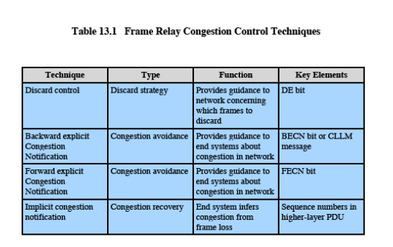
FR Congestion Control
Notes:
Congestion control is difficult for a frame relay network because its protocol has been streamlined to maximize throughput and efficiency. Congestion control is the joint responsibility of the network and the end users. The network is in the best position to monitor the degree of congestion, while the end users are in the best position to control congestion by limiting the flow of traffic. Some congestion control techniques defined in the various ITU-T and ANSI documents are:
Discard strategy deals with the most fundamental response to congestion: When congestion becomes severe enough, the network is forced to discard frames.
Congestion avoidance procedures are used at the onset of congestion to minimize the effect on the network. These procedures would be initiated at or prior to point A in Figure 13.4 to prevent congestion from progressing to point B. Near point A there would be little evidence available to end users that congestion is increasing. This needs some explicit signaling mechanism from the network to trigger congestion avoidance.
Congestion recovery procedures are used to prevent network collapse in the face of severe congestion. These procedures are typically initiated when the network has begun to drop frames due to congestion. Such dropped frames will be reported by some higher layer of software (eg., LAPF or TCP) and serve as an implicit signaling mechanism. Congestion recovery procedures operate around point B and within the region of severe congestion, as shown in Stallings DCC8e Figure 13.4.

Slide 19
Traffic Rate Management
must discard frames to cope with congestion
  arbitrarily, no regard for source
  no reward for restraint so end systems transmit as fast as possible
  Committed information rate (CIR)
    data in excess of this liable to discard
    not guaranteed in extreme congestion situations
    aggregate CIR should not exceed physical data rate
Committed burst size (B_{c})
Excess burst size (B_{e})
Notes:
As a last resort, a frame-relaying network must discard frames to cope with congestion. Because each frame handler in the network has finite memory available for queuing frames (Stallings DCC8e Figure 13.2), it is possible for a queue to overflow, necessitating the discard of some frame.
The simplest way to cope with congestion is for the frame-relaying network to discard frames arbitrarily, with no regard to the source of a particular frame. In that case, because there is no reward for restraint, the best strategy for any individual end system is to transmit frames as rapidly as possible, which exacerbates the congestion problem.
To provide for a fairer allocation of resources, the frame relay bearer service includes the concept of a committed information rate (CIR). This is a rate, in bits per second, that the network agrees to support for a particular frame-mode connection. Any data transmitted in excess of the CIR are vulnerable to discard in the event of congestion. Despite the use of the term committed, there is no guarantee that even the CIR will be met. In cases of extreme congestion, the network may be forced to provide a service at less than the CIR for a given connection. However, when it comes time to discard frames, the network will choose to discard frames on connections that are exceeding their CIR before discarding frames that are within their CIR.
The CIR, by itself, does not provide much flexibility in dealing with traffic rates. connection and then makes a decision based on the amount of data received during that interval. Two additional parameters, assigned on permanent connections and negotiated on switched connections, are needed. These are the Committed and excess burst sizes.

Slide 20
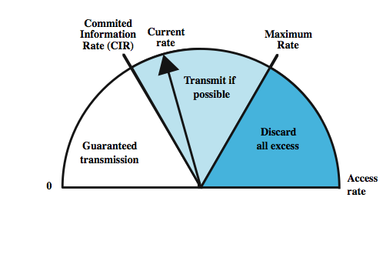
Operation of CIR
Notes:
The CIR provides a way of discriminating among frames in determining which frames to discard in the face of congestion. Discrimination is indicated by means of the discard eligibility (DE) bit in the LAPF frame (see Stallings DCC8e Figure 10.16). The frame handler to which the user's station attaches performs a metering function (as shown here in Stallings DCC8e Figure 13.6). If the user is sending data at less than the CIR, the incoming frame handler does not alter the DE bit. If the rate exceeds the CIR, the incoming frame handler will set the DE bit on the excess frames and then forward them; such frames may get through or may be discarded if congestion is encountered. Finally, a maximum rate is defined, such that any frames above the maximum are discarded at the entry frame handler. The CIR, by itself, does not provide much flexibility in dealing with traffic rates. In practice, a frame handler measures traffic over each logical connection for a time interval specific to that connection and then makes a decision based on the amount of data received during that interval. Additional parameters needed for this are:
• Committed burst size (B_{c}): The maximum amount data that the network agrees to transfer, under normal conditions, over a measurement interval T. These data may or may not be contiguous (i.e., they may appear in one frame or in several frames).
• Excess burst size (B_{e}): The maximum amount of data in excess of B_{c} that the network will attempt to transfer, under normal conditions, over a measurement interval T. These data are uncommitted in the sense that the network does not commit to delivery under normal conditions.

Slide 21
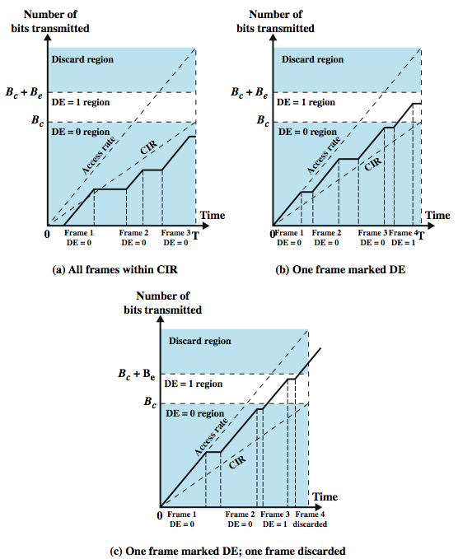
Relationship
Among
Congestion
Parameters
Notes:
Stallings DCC8e Figure 13.7, based on a figure in ITU-T Recommendation I.370, illustrates the relationship among these parameters. On each graph, the solid line plots the cumulative number of information bits transferred over a given connection since time T = 0. The dashed line labeled Access Rate represents the data rate over the channel containing this connection. The dashed line labeled CIR represents the committed information rate over the measurement interval T. Note that when a frame is being transmitted, the solid line is parallel to the Access Rate line; when a frame is transmitted on a channel, that channel is dedicated to the transmission of that frame. When no frame is being transmitted, the solid line is horizontal.
Stallings DCC8e Figure 13.7a shows an example in which three frames are transmitted within the measurement interval and the total number of bits in the three frames is less than B_{c}. Note that during the transmission of the first frame, the actual transmission rate temporarily exceeds the CIR. This is of no consequence because the frame handler is only concerned with the cumulative number of bits transmitted over the entire interval. In Figure 13.7b, the last frame transmitted during the interval causes the cumulative number of bits transmitted to exceed B_{c}. Accordingly, the DE bit of that frame is set by the frame handler. In Figure 13.7c, the third frame exceeds B_{c} and so is labeled for potential discard. The fourth frame exceeds B_{c} + B_{e} and is discarded.

Slide 22
Congestion Avoidance using Explicit Signaling
network alerts end systems of growing congestion using
  backward explicit congestion notification
  forward explicit congestion notification
frame handler monitors its queues
may notify some or all logical connections
user response: reduce rate
Notes:
Explicit congestion avoidance techniques aim to use as much of the available capacity in a frame relay network as possible but still react to congestion in a controlled and fair manner. In general terms, for explicit congestion avoidance, the network alerts end systems to growing congestion within the network and the end systems take steps to reduce the offered load to the network. For explicit signaling, two bits in the address field of each frame are provided. Either bit may be set by any frame handler that detects congestion. These bits constitute signals from the network to the end user. The two bits are
• Backward explicit congestion notification (BECN): Notifies user that congestion avoidance procedures should be initiated where applicable for traffic in the opposite direction of the received frame.
• Forward explicit congestion notification (FECN): Notifies the user that congestion avoidance procedures should be initiated where applicable for traffic in the same direction as the received frame. It indicates that this frame, on this logical connection, has encountered congested resources.
Both network & user must manage these. In the network, it is necessary for each frame handler to monitor its queuing behavior. If queue lengths begin to grow to a dangerous level, then either FECN or BECN bits or a combination should be set to try to reduce the flow of frames through that frame handler. The user response is determined by the receipt of BECN or FECN signals. For a BECN signal the user simply reduces the rate at which frames are transmitted until the signal ceases. For a FECN it requires the user to notify its peer user of this connection to restrict its flow of frames.

Slide 23
ATM Traffic Management
high speed, small cell size, limited overhead bits
still evolving
reasons existing tools are inadequate for ATM
  majority of traffic not amenable to flow control
  feedback slow due to reduced transmission time compared with propagation delay
  wide range of application demands
  different traffic patterns
  different network services
  high speed switching and transmission increases volatility
Notes:
Because of their high speed and small cell size, ATM networks present difficulties in effectively controlling congestion not found in other types of data networks. The complexity of the problem is compounded by the limited number of overhead bits available for exerting control over the flow of user cells. This area is currently the subject of intense research, and approaches to traffic and congestion control are still evolving. Existing types of congestion control schemes are inadequate for ATM networks, including for the following reasons:
• The majority of traffic is not amenable to flow control, eg. voice and video traffic sources cannot stop generating cells even when network is congested.
• Feedback is slow due to the drastically reduced cell transmission time compared to propagation delays across the network.
• ATM networks typically support a wide range of applications requiring capacity ranging from a few kbps to several hundred Mbps. Simple-minded congestion control schemes end up penalizing one end or other of spectrum.
• Applications on ATM networks may generate very different traffic patterns, difficult for conventional congestion control techniques to handle fairly.
• Different applications on ATM networks require different network services
• The very high speeds in switching and transmission make ATM networks more volatile in terms of congestion and traffic control. A scheme that relies heavily on reacting to changing conditions will produce extreme and wasteful fluctuations in routing policy and flow control.

Slide 24
Latency/Speed Effects
consider ATM at 150Mbps
takes ~2.8x10⁻⁶ seconds to insert single cell
time to traverse network depends on propagation delay and switching delay
assume propagation at two-thirds speed of light
if source and destination on opposite sides of USA, propagation time ~ 48x10⁻³ seconds
given implicit congestion control, by the time dropped cell notification has reached source, 7.2x10⁶ bits have been transmitted
this is not a good strategy for ATM
Notes:
Two key performance issues that relate to the preceding points are latency/speed effects and cell delay variation. Consider the transfer of ATM cells over a network at a data rate of 150 Mbps. At that rate, it takes (53 × 8 bits)/(150 × 10⁶ bps) ≈ 2.8 × 10^{–6} seconds to insert a single cell onto the network. The time it takes to transfer the cell from the source to the destination user will depend on the number of intermediate ATM switches, the switching time at each switch, and the propagation time along all links in the path from source to destination. For simplicity, ignore ATM switching delays and assume propagation at the two-thirds the speed of light. Then, if source and destination are on opposite coasts of the United States, the round-trip propagation delay is about 48 × 10^{–3} seconds.
With these conditions in place, suppose that source A is performing a long file transfer to destination B and that implicit congestion control is being used (i.e., there are no explicit congestion notifications; the source deduces the presence of congestion by the loss of data). If the network drops a cell due to congestion, B can return a reject message to A, which must then retransmit the dropped cell and possibly all subsequent cells. But by the time the notification gets back to A, it has transmitted an additional N = 7.2 48 × 10⁶ bits. Over 7 megabits have been transmitted before A can react to the congestion indication. This calculation helps to explain why the techniques that are satisfactory for more traditional networks break down when dealing with ATM WANs.

Slide 25
Cell Delay Variation
for ATM voice/video, data is a stream of cells
delay across network must be short
rate of delivery must be constant
there will always be some variation in transit
delay cell delivery to application so that constant bit rate can be maintained to application
Notes:
For an ATM network, voice and video signals can be digitized and transmitted as a stream of cells. A key requirement, especially for voice, is that the delay across the network be short. Generally, this will be the case for ATM networks. As we have discussed, ATM is designed to minimize the processing and transmission overhead internal to the network so that very fast cell switching and routing is possible. There is another important requirement that to some extent conflicts with the preceding requirement, namely that the rate of delivery of cells to the destination user must be constant. It is inevitable that there will be some variability in the rate of delivery of cells due both to effects within the network and at the source UNI; we summarize these effects presently.

Slide 26
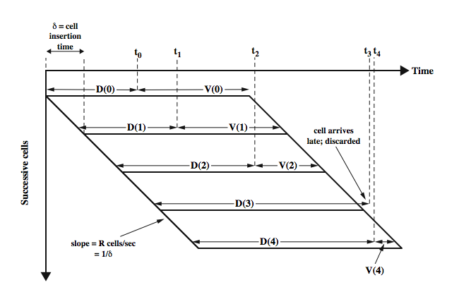
Timing of CBR Cells
Notes:
First, let us consider how the destination user might cope with variations in the delay of cells as they transit from source user to destination user. A general procedure for achieving a constant bit rate (CBR) is illustrated in Stallings DCC8e Figure 13.8. Let D(i) represent the end-to-end delay experienced by the ith cell. The destination system does not know the exact amount of this delay: there is no timestamp information associated with each cell and, even if there were, it is impossible to keep source and destination clocks perfectly synchronized. When the first cell on a connection arrives at time t₀, the target user delays the cell an additional amount V(0) prior to delivery to the application. V(0) is an estimate of the amount of cell delay variation that this application can tolerate and that is likely to be produced by the network. Subsequent cells are delayed so that they are delivered to the user at a constant rate of R cells per second. The time between delivery of cells to the target application (time between the start of delivery of one cell and the start of delivery of the next cell) is therefore δ = 1/R. To achieve a constant rate, the next cell is delayed a variable amount V(i) = V(i-1) – [t_{i} – (t_{i–1} + δ)]. If the computed value of V(i) is negative, then that cell is discarded. The result is that data is delivered to the higher layer at a constant bit rate, with occasional gaps due to dropped cells. The amount of the initial delay V(0), which is also the average delay applied to all incoming cells, is a function of the anticipated cell delay variation. To minimize this delay, a subscriber will therefore request a minimal cell delay variation from the network provider. This leads to a tradeoff: cell delay variation can be reduced by increasing the data rate at the UNI relative to the load and by increasing resources within the network.

Slide 27
Network Contribution to
Cell Delay Variation
in packet switched networks is due to queuing delays and routing decision time
in Frame relay networks is similar
in ATM networks
  less than frame relay
  ATM protocol designed to minimize processing overheads at switches
  ATM switches have very high throughput
  only noticeable delay is from congestion
  must not accept load that causes congestion
Notes:
One component of cell delay variation is due to events within the network. For packet-switching networks, packet delay variation can be considerable due to queuing effects at each of the intermediate switching nodes and the processing time required to analyze packet headers and perform routing. To a much lesser extent, this is also true of frame delay variation in frame relay networks. In the case of ATM networks, cell delay variations due to network effects are likely to be even less than for frame relay. The principal reasons for this are that firstly the ATM protocol is designed to minimize processing overhead at intermediate switching nodes. The cells are fixed size with fixed header formats, and there is no flow control or error control processing required. Also, to accommodate the high speeds of ATM networks, ATM switches have had to be designed to provide extremely high throughput. Thus, the processing time for an individual cell at a node is negligible.
The only factor that could lead to noticeable cell delay variation within the network is congestion. If the network begins to become congested, either cells must be discarded or there will be a buildup of queuing delays at affected switches. Thus, it is important that the total load accepted by the network at any time not be such as to cause congestion.

Slide 28
Cell Delay Variation
At The UNI
application produces data at fixed rate
3 layers of ATM processing causes delay
  interleaving cells from different connections
  operation and maintenance cell interleaving
  if using synchronous digital hierarchy frames, these are inserted at physical layer
cannot predict these delays
Notes:
Even if an application generates data for transmission at a constant bit rate, cell delay variation can occur at the source due to the processing that takes place at the three layers of the ATM model.
The ATM layer encapsulates each segment into a 53-octet cell. These cells must be interleaved and delivered to the physical layer to be transmitted at the data rate of the physical link. Delay is introduced into this interleaving process: If two cells from different connections arrive at the ATM layer at overlapping times, one of the cells must be delayed by the amount of the overlap. In addition, the ATM layer is generating OAM (operation and maintenance) cells that must also be interleaved with user cells.
At the physical layer, there is opportunity for the introduction of further cell delays. For example, if cells are transmitted in SDH (synchronous digital hierarchy) frames, overhead bits for those frames will be inserted onto the physical link, delaying bits from the ATM layer.
None of the delays just listed can be predicted in any detail, and none follow any repetitive pattern. Accordingly, there is a random element to the time interval between reception of data at the ATM layer from the AAL and the transmission of that data in a cell across the UNI.

Slide 29
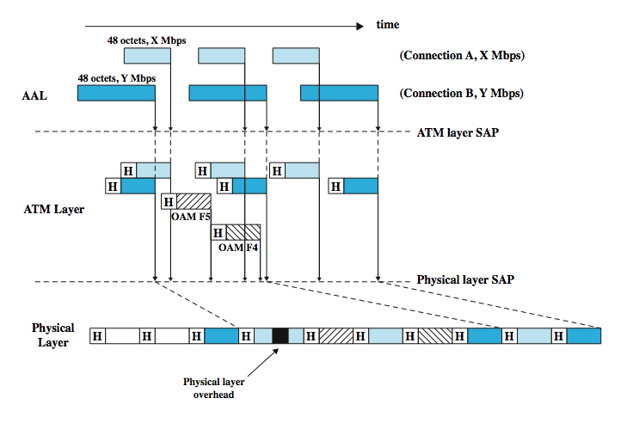
Origins of Cell Delay Variation
Notes:
Stallings DCC8e Figure 13.9 illustrates the potential causes of cell delay variation. In this example, ATM connections A and B support user data rates of X and Y Mbps, respectively (X > Y). At the AAL level, data are segmented into 48-octet blocks. Note that on a time diagram, the blocks appear to be of different sizes for the two connections; specifically, the time required to generate a 48-octet block of data, in microseconds, is 48 x 8 / data rate. As described previously, these are then subject to delays at various layers - due to overlap, interleaving, physical link insertion.

Slide 30
Traffic and Congestion
Control Framework
ATM layer traffic and congestion control should support QoS classes for all foreseeable network services
should not rely on AAL protocols that are network specific, nor higher level application specific protocols
should minimize network and end to end system complexity
Notes:
I.371 lists the following objectives of ATM layer traffic and congestion control:
• ATM layer traffic and congestion control should support a set of ATM layer QoS classes sufficient for all foreseeable network services; the specification of these QoS classes should be consistent with network performance parameters currently under study.
• ATM layer traffic and congestion control should not rely on AAL protocols that are network service specific, nor on higher-layer protocols that are application specific. Protocol layers above the ATM layer may make use of information provided by the ATM layer to improve the utility those protocols can derive from the network.
• The design of an optimum set of ATM layer traffic controls and congestion controls should minimize network and end-system complexity while maximizing network utilization.

Slide 31
Timings Considered
timing intervals considered:
  cell insertion time
  round trip propagation time
  connection duration
  long term
traffic control strategy then must:
  determine whether a given new connection can be accommodated
  agree performance parameters with subscriber
now review various control techniques
Notes:
To meet these objectives, ITU-T and the ATM Forum have defined a collection of traffic and congestion control functions that operate across a spectrum of timing intervals. Stallings DCC8e Table 13.2 lists these functions with respect to the response times within which they operate. Four levels of timing are considered:
• Cell insertion time: Functions at this level react immediately to cells as they are transmitted.
• Round-trip propagation time: At this level, the network responds within the lifetime of a cell in the network and may provide feedback indications to the source.
• Connection duration: At this level, the network determines whether a new connection at a given QoS can be accommodated and what performance levels will be agreed to.
• Long term: These are controls that affect more than one ATM connection and are established for long-term use.
The essence of the traffic control strategy is based on (1) determining whether a given new ATM connection can be accommodated and (2) agreeing with the subscriber on the performance parameters that will be supported. In effect, the subscriber and the network enter into a traffic contract.
ATM traffic management function refers to the set of actions taken by the network to avoid congestion conditions or to minimize congestion effects. We will now highlight the a number of these techniques over the next few slides.

Slide 32
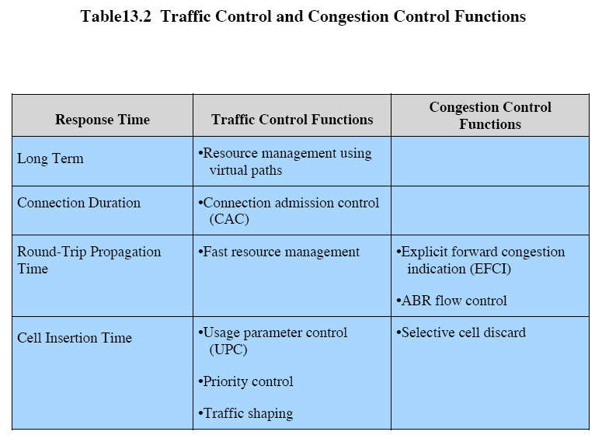
Notes:
To meet these objectives, ITU-T and the ATM Forum have defined a collection of traffic and congestion control functions that operate across a spectrum of timing intervals. Stallings DCC8e Table 13.2 lists these functions with respect to the response times within which they operate. Four levels of timing are considered:
• Cell insertion time: Functions at this level react immediately to cells as they are transmitted.
• Round-trip propagation time: At this level, the network responds within the lifetime of a cell in the network and may provide feedback indications to the source.
• Connection duration: At this level, the network determines whether a new connection at a given QoS can be accommodated and what performance levels will be agreed to.
• Long term: These are controls that affect more than one ATM connection and are established for long-term use.
The essence of the traffic control strategy is based on (1) determining whether a given new ATM connection can be accommodated and (2) agreeing with the subscriber on the performance parameters that will be supported. In effect, the subscriber and the network enter into a traffic contract.
ATM traffic management function refers to the set of actions taken by the network to avoid congestion conditions or to minimize congestion effects. We will now highlight the a number of these techniques over the next few slides.

Slide 33
Resource Management Using Virtual Paths
separate traffic flow according to service characteristics on a virtual path
  user to user application
  user to network application
  network to network application
QoS parameters concerned with are:
  cell loss ratio
  cell transfer delay
  cell delay variation
Notes:
The essential concept behind network resource management is to allocate network resources in such a way as to separate traffic flows according to service characteristics. So far, the only specific traffic control function based on network resource management defined by the ATM Forum deals with the use of virtual paths. The network provides aggregate capacity and performance characteristics on the virtual path, and these are shared by the virtual connections. There are three cases to consider:
• User-to-user application: The VPC extends between a pair of UNIs. In this case the network has no knowledge of the QoS of the individual VCCs within a VPC. It is the user's responsibility to assure that the aggregate demand from the VCCs can be accommodated by the VPC.
• User-to-network application: The VPC extends between a UNI and a network node. In this case, the network is aware of the QoS of the VCCs within the VPC and has to accommodate them.
• Network-to-network application: The VPC extends between two network nodes. Again, in this case, the network is aware of the QoS of the VCCs within the VPC and has to accommodate them.
The QoS parameters that are of primary concern for network resource management are cell loss ratio, cell transfer delay, and cell delay variation, all of which are affected by the amount of resources devoted to the VPC by the network. If a VCC extends through multiple VPCs, then the performance on that VCC depends on the performances of the consecutive VPCs and on how the connection is handled at any node that performs VCC-related functions.

Slide 34
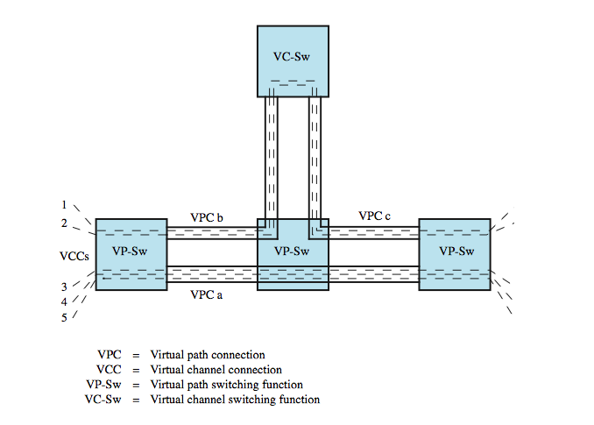
Configuration of
VCCs and VPCs
VCCs 1 and 2 experience a performance that depends on VPCs b and c. This may differ from the performance experienced by VCCs 3, 4, and 5
Notes:
Stallings DCC8e Figure 13.10 gives an example. VCCs 1 and 2 experience a performance that depends on VPCs b and c and on how these VCCs are handled by the intermediate nodes. This may differ from the performance experienced by VCCs 3, 4, and 5. The performance of each VPC depends on the capacity of that VPC and the traffic characteristics of the VCCs contained within the VPC. The performance of each VCC-related function depends on the switching/processing speed at the node and on the relative priority with which various cells are handled. There are a number of alternatives for the way in which VCCs are grouped and the type of performance they experience. If all of the VCCs within a VPC are handled similarly, then they should experience similar expected network performance, in terms of cell loss ratio, cell transfer delay, and cell delay variation. Alternatively, when different VCCs within the same VPC require different QoS, the VPC performance objective agreed by network and subscriber should be set suitably for the most demanding VCC requirement.

Slide 35
Allocating VCCs within VPC
all VCCs within VPC should experience similar network performance
options for allocation:
  aggregate peak demand
    set VPC capacity to total of all peak VCC rates
    will meet peak demands, but often underutilized
  statistical multiplexing
    set VPC capacity to more than average VCC rates
    will see greater variation but better utilization
Notes:
In either case, with multiple VCCs within the same VPC, the network has two general options for allocating capacity to the VPC:
• Aggregate peak demand: The network may set the capacity (data rate) of the VPC equal to the total of the peak data rates of all of the VCCs within the VPC. The advantage of this approach is that each VCC can be given a QoS that accommodates its peak demand. The disadvantage is that most of the time, the VPC capacity will not be fully utilized and therefore the network will have underutilized resources.
• Statistical multiplexing: If the network sets the capacity of the VPC to be greater than or equal to the average data rates of all the VCCs but less than the aggregate peak demand, then a statistical multiplexing service is supplied. With statistical multiplexing, VCCs experience greater cell delay variation and greater cell transfer delay. Depending on the size of buffers used to queue cells for transmission, VCCs may also experience greater cell loss ratio. This approach has the advantage of more efficient utilization of capacity and is attractive if the VCCs can tolerate the lower QoS
When statistical multiplexing is used, it is preferable to group VCCs into VPCs on the basis of similar traffic characteristics and similar QoS requirements. If dissimilar VCCs share the same VPC and statistical multiplexing is used, it is difficult to provide fair access to both high-demand and low-demand traffic streams.

Slide 36
Connection Admission Control
first line of defense
user specifies traffic characteristics for new connection (VCC or VPC) by selecting a QoS
network accepts connection only if it can meet the demand
traffic contract
  peak cell rate
  cell delay variation
  sustainable cell rate
  burst tolerance
Notes:
Connection admission control is the first line of defense for the network in protecting itself from excessive loads. In essence, when a user requests a new VPC or VCC, the user must specify (implicitly or explicitly) the traffic characteristics in both directions for that connection. The user selects traffic characteristics by selecting a QoS from among the QoS classes that the network provides. The network accepts the connection only if it can commit the resources necessary to support that traffic level while at the same time maintaining the agreed QoS of existing connections. By accepting the connection, the network forms a traffic contract with the user. Once the connection is accepted, the network continues to provide the agreed QoS as long as the user complies with the traffic contract. The traffic contract may consist of the four parameters: peak cell rate (PCR), cell delay variation (CDV), sustainable cell rate (SCR), and burst tolerance. Only the first two parameters are relevant for a constant-bit-rate (CBR) source; all four parameters may be used for variable-bit-rate (VBR) sources.
peak cell rate (PCR) - the maximum rate at which cells are generated by the source on this connection, but need to account for cell delay variation …
cell delay variation (CDV) - introduced by various factors (see Figure 13.9) will affect timing, causing cells to clump up and gaps to occur
sustainable cell rate (SCR) - like PCR but applied to an average rate of cell generation rather than a peak rate, for VBR links
burst tolerance - like CDV but applied to an average rate of cell generation rather than a peak rate , for VBR links
With this, the network can to utilize network resources more efficiently.

Slide 37
Usage Parameter Control
UPC function monitors a connection to ensure traffic obeys contract
purpose is to protect network resources from overload by one connection
done on VCC and VPC
peak cell rate and cell delay variation
sustainable cell rate and burst tolerance
UPC discards cells outside traffic contract
Notes:
Once a connection has been accepted by the connection admission control function, the usage parameter control (UPC) function of the network monitors the connection to determine whether the traffic conforms to the traffic contract. The main purpose of usage parameter control is to protect network resources from an overload on one connection that would adversely affect the QoS on other connections by detecting violations of assigned parameters and taking appropriate actions. Usage parameter control can be done at both the virtual path and virtual channel levels. Of these, the more important is VPC-level control, because network resources are, in general, initially allocated on the basis of virtual paths, with the virtual path capacity shared among the member virtual channels. There are two separate functions encompassed by usage parameter control:
• Control of peak cell rate and the associated cell delay variation (CDV) - a traffic flow is compliant if the peak rate of cell transmission does not exceed the agreed peak cell rate, subject to the possibility of cell delay variation within the agreed bound. I.371 defines an algorithm, the peak cell rate algorithm, that monitors compliance (see text for more details).
• Control of sustainable cell rate and the associated burst tolerance - the same algorithm, with different parameters, can be used to monitor the sustainable cell rate and the associated burst tolerance.
To perform usage parameter control, the network must act on the results of the algorithm. The simplest strategy is that compliant cells are passed along and noncompliant cells are discarded at the point of the UPC function.

Slide 38
Selective Cell Discard
when network at point beyond UPC discards (CLP=1) cells
aim to discard lower-priority cells when congested to protect higher-priority cells
  note. can’t distinguish between cells originally labeled lower priority, verses those tagged by UPC function
Notes:
Selective cell discard comes into play when the network, at some point beyond the UPC function, discards (CLP = 1) cells. The objective is to discard lower-priority cells during congestion to protect the performance for higher-priority cells. Note that the network has no way to discriminate between cells that were labeled as lower priority by the source and cells that were tagged by the UPC function.

Slide 39
Traffic Shaping
UPC provides a form of traffic policing
can be desirable to also shape traffic
smoothing out traffic flow
reducing cell clumping
token bucket
Notes:
The UPC algorithm is referred to as a form of traffic policing. Traffic policing occurs when a flow of data is regulated so that cells (or frames or packets) that exceed a certain performance level are discarded or tagged. It may be desirable to supplement a traffic-policing policy with a traffic-shaping policy. Traffic shaping is used to smooth out a traffic flow and reduce cell clumping. This can result in a fairer allocation of resources and a reduced average delay time.
A simple approach to traffic shaping is to use a form of the UPC algorithm known as token bucket. In contrast to the UPC algorithm, which simply monitors the traffic and tags or discards noncompliant cells, a traffic-shaping token bucket controls the flow of compliant cells

Slide 40
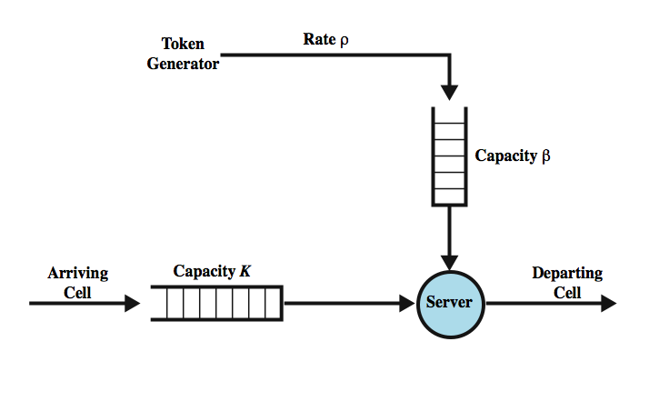
Token Bucket for
Traffic Shaping
Notes:
Stallings DCC8e Figure 13.11 illustrates the basic principle of the token bucket. A token generator produces tokens at a rate of ρ tokens per second and places these in the token bucket, which has a maximum capacity of β tokens. Cells arriving from the source are placed in a buffer with a maximum capacity of K cells. To transmit a cell through the server, one token must be removed from the bucket. If the token bucket is empty, the cell is queued waiting for the next token. The result of this scheme is that if there is a backlog of cells and an empty bucket, then cells are emitted at a smooth flow of ρ cells per second with no cell delay variation until the backlog is cleared. Thus, the token bucket smoothes out bursts of cells.

Slide 41
GFR Traffic Management
guaranteed frame rate (GFR) as simple as UBR from end system viewpoint
places modest requirements on ATM network
end system does no policing or shaping of traffic
may transmit at line rate of ATM adaptor
no guarantee of frame delivery (under congestion)
  so higher layer (eg. TCP) must do congestion control
user can reserve capacity for each VC
  ensures application can send at min rate with no loss
  if no congestion, higher rates maybe used
Notes:
GFR (guaranteed frame rate) provides a service that is as simple as UBR (unspecified bit rate) from the end system's point of view while placing a relatively modest requirement on the ATM network elements in terms of processing complexity and overhead. In essence, with GFR, an end system does no policing or shaping of the traffic it transmits but may transmit at the line rate of the ATM adapter. As with UBR, there is no guarantee of frame delivery. It is up to a higher layer, such as TCP, to react to congestion that results in dropped frames by employing the window management and congestion control techniques discussed in Part Five. Unlike UBR, GFR allows the user to reserve a certain amount of capacity, in terms of a cell rate, for each GFR VC. A GFR reservation assures an application that it may transmit at a minimum rate without losses. If the network is not congested, the user will be able to transmit at a higher rate.

Slide 42
Frame Recognition
GFR recognizes frames as well as cells
when congested, network discards whole frame rather than individual cells
all cells of a frame have same CLP bit setting
CLP=1 AAL5 frames lower priority (best effort)
CLP=0 frames minimum guaranteed capacity
Notes:
A distinctive characteristic of GFR is that it requires the network to recognize frames as well as cells. When congestion occurs, the network discards entire frames rather than individual cells. Further, GFR requires that all of the cells of a frame have the same CLP bit setting. The CLP = 1 AAL5 frames are treated as lower-priority frames that are to be transmitted on a best-effort basis. The minimum guaranteed capacity applies to the CLP = 0 frames.

Slide 43
GFR Contract Parameters
Peak cell rate (PCR)
Minimum cell rate (MCR)
Maximum burst size (MBS)
Maximum frame size (MFS)
Cell delay variation tolerance (CDVT)
Notes:
The GFR traffic contract consists of the following parameters:
• Peak cell rate (PCR)
• Minimum cell rate (MCR)
• Maximum burst size (MBS)
• Maximum frame size (MFS)
• Cell delay variation tolerance (CDVT)

Slide 44
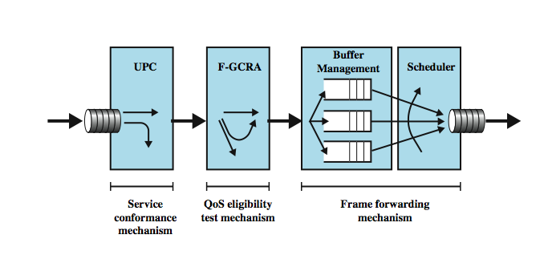
Components of GFR System Supporting Rate Guarantees
Notes:
There are three basic approaches that can be used by the network to provide per-VC guarantees for GFR and to enable a number of users to efficiently use and fairly share the available network capacity:
• Tagging and policing
• Buffer management
• Scheduling
These approaches can be combined in various ways in an ATM network elements to yield a number of possible GFR implementations.
Stallings DCC8e Figure 13.12 illustrates their use.

Slide 45
Tagging and Policing
discriminates between frames that conform to contract and those that don’t
set CLP=1 on all cells in frame if not
  gives lower priority
maybe done by network or source
network may discard CLP=1 cells
  policing
Notes:
Tagging is used to discriminate between frames that conform to the GFR traffic contract and those that do not. The network element doing the conformance checking sets CLP = 1 on all cells of each frame that does not conform. Because tagged cells are assumed to be in violation of the traffic contract, they are given a lower quality of service than untagged cells by subsequent mechanisms, such as buffer management and scheduling. Tagging can be done by the network, especially the network element at the ingress to the ATM network. But tagging may also be done by the source end system to indicate less important frames.
The network, at either the ingress network element or at other ATM switching elements, may also choose to discard cells of nonconforming frames (i.e., cells with CLP = 1). Cell discard is considered a policing function.

Slide 46
Buffer Management
deals with treatment of buffered cells
congestion indicated by high buffer occupancy
will discard tagged cells in preference to untagged cells
  including ones already in buffer to make room
may do per VC buffering for fairness
cell discard based on queue-specific thresholds
Notes:
Buffer management mechanisms have to do with the way in which cells are treated that have been buffered at a network switch or that arrive at a network switch and must be buffered prior to forwarding. When a congestion condition exists, as reflected by high buffer occupancy, a network element will discard tagged cells in preference to untagged cells. In particular, a network element may discard a tagged cell that is already in a buffer to make room for an incoming untagged cell. To provide fair and efficient use of buffer resources, a network element may perform per-VC buffering, dedicating a certain amount of buffer space to individual VCs. Then, on the basis of the traffic contracts for each VC and the buffer occupancy per VC, the network element can make decisions concerning cell discard. That is, cell discard can be based on queue-specific occupancy thresholds.

Slide 47
Scheduling
preferential treatment to untagged cells
separate queues for each VC
make per-VC scheduling decisions
enables control of outgoing rate of VCs
VCs get fair capacity allocation
still meet contract
Notes:
A scheduling function, at minimum, can give preferential treatment to untagged cells over tagged cells. A network can also maintain separate queues for each VC and make per-VC scheduling decisions. Thus, within each queue, a first-come, first-served discipline can be used, perhaps modified to give higher priority for scheduling to CLP = 0 frames. Scheduling among the queues enables the network element to control the outgoing rate of individual VCs and thus ensure that individual VCs receive a fair allocation of capacity while meeting traffic contract requirements for minimum cell rate for each VC.

Slide 48
GFC Conformance Definition
UPC function monitors each active VC
to ensure traffic conforms to contract
tag or discard nonconforming cells
frame conforms if all cells conform
a cell conforms if:
  rate of cells is within contract
  all cells in frame have same CLP
  frame satisfies MFS parameter
    check if either last cell in frame or cell count < MFS
Notes:
The first function indicated in Stallings DCC8e Figure 13.12 (on earlier slide) is a UPC function. UPC monitors each active VC to ensure that the traffic on each connection conforms to the traffic contract, and tags or discards nonconforming cells. A frame is conforming if all of its cells are conforming, and is nonconforming if one or more cells are nonconforming. Three conditions must be met for a cell to be conforming:
1. The rate of cells must be within the cell rate contract.
2. All cells of a frame must have the same CLP value. Thus, the CLP bit of the current cell must have the same value as the CLP bit of the first cell of the frame.
3. The frame containing this cell must satisfy the MFS parameter. This condition can be met by performing the following test on each cell: the cell either is the last cell of the frame or the number of cells in the frame up to and including this cell is less than MFS.

Slide 49
QoS Eligibility Test
two stage filtering process
a frame is tested for conformance to contract
  if not, may discard or tag
  set upper bound & penalize cells above upper bound
  do expect attempt to deliver tagged cells
determine frames eligible for QoS guarantees
  under GFR contract for VC
  set lower bound on traffic
  frames in traffic flow below threshold are eligible
Notes:
The first two boxes in Stallings DCC8e Figure 13.12 show what amounts to a two-stage filtering process. First, frames are tested for conformance to the traffic contract. Frames that do not conform may be discarded immediately. If a nonconforming frame is not discarded, its cells are tagged (CLP = 1), making them vulnerable to discard later on in the network. This first stage is therefore looking at an upper bound on traffic and penalizing cells that push the traffic flow above the upper bound. The second stage of filtering determines which frames are eligible for QoS guarantees under the GFR contract for a given VC. This stage is looking at a lower bound on traffic; over a given period of time, those frames that constitute a traffic flow below the defined threshold are designated as eligible for QoS handling.
A network may discard or tag any cells that are not eligible. However, TM 4.1 states that it is expected that an implementation will attempt to deliver conforming but ineligible traffic is on the basis of available resources, with each GFR connection being provided at each link with a fair share of the local residual bandwidth. The specification does not attempt to define a criterion by which to determine if a given implementation meets the aforementioned expectation.

Slide 50
GFR VC Frame Categories
nonconforming frame (above upper bound)
  cells of this frame will be tagged or discarded
conforming but ineligible frames (in-between)
  cells will receive a best-effort service
conforming and eligible frames (under lower bound)
  cells will receive a guarantee of delivery
form of cell rate algorithm is used
Notes:
Therefore, the frames transmitted on a GFR VC fall into three categories:
• Nonconforming frame: Cells of this frame will be tagged or discarded.
• Conforming but ineligible frames: Cells will receive a best-effort service.
• Conforming and eligible frames: Cells will receive a guarantee of delivery.
To determine eligibility, a form of the cell rate algorithm referred to in Section 13.6 is used.

Slide 51
Summary
congestion effects
congestion control
traffic management
frame relay congestion control
ATM congestion control
Notes:
Chapter13 summary.

